Slide 1

By Jesse, David, Charles

Slide 2
Objective
Objective
  To provide a complete enumeration and state table of the driver side mirror
Topics to Discuss
  Requirements
  Derived Requirements
  Interface
  State Diagram
    Stimuli
    Output

Slide 3
Requirements
A switch is used to toggle between the driver & passenger side mirrors
The driver side ECU starts when the key is in the “start” position
Each mirror can be moved in four directions, with each direction having an extreme position.
A request to move a mirror beyond its extreme position causes an error to be sent via the CAN bus
Each mirror has a heater that comes on when the mirror is 2 degrees Celsius cooler than the outside temperature, it will remain on for 10 seconds before turning off for at least 120 seconds.
The engine must be running for the mirror heaters to come online
The state of the engine is sent via the MRUN signal (MRUN=1 means engine on)

Slide 4
Derived Requirements
The state of the engine is sent via the MRUN signal (MRUN=0 when the engine is off)
The driver side ECU is inactive prior to the car being started, thus all signals to the driver side ECU other than MRUN=1 are ignored
The ECU resets each time it receives an MRUN=1 signal
When the mirror is toggled for the passenger side mirror, all mirror adjustments signals are sent to the Passenger side ECU.
The state of the ECU is updated if the state of the engine changes
Extraneous temperate and timer signals are ignored

Slide 5
Interface
Controller Area Network (CAN) bus
  Serves as the primary means of communication for all the electronic parts of the car
Driver Side Mirror
  The component includes the mirror, the mirror motors, the mirror heating coil, extreme position sensors, and two timers
Mirror Adjustment Panel
  This panel is located next to the steering wheel and houses the mirror adjustment stick and the toggle switch

Slide 6
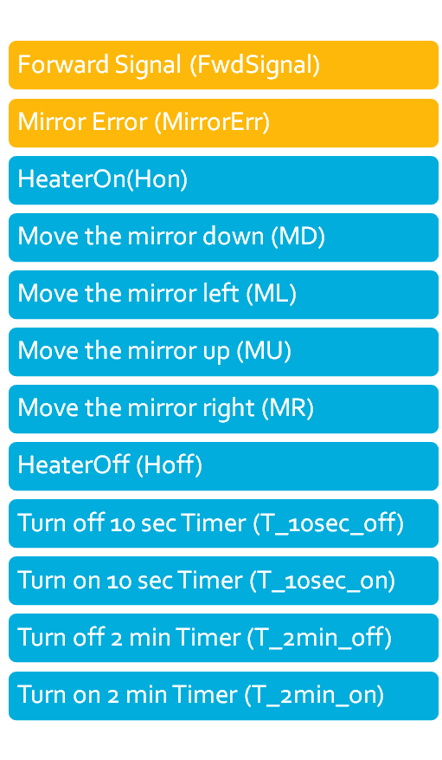
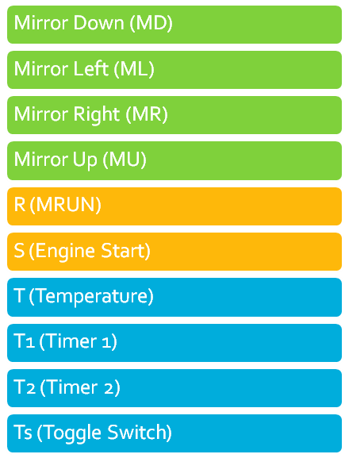
Stimuli and Outputs
Output (To)
Stimuli (From)
Legend
Mirror Adjustment Panel
(CAN) Bus
Driver Side ECU

Slide 7
State Diagram
Car Off
S/Null
Car On, Engine Off
Mrun=1/Null
Car On, Engine on
T/Hon,
T_10sec_on
Car On, Engine on, T, T1
Car On, Engine on, T
T1/
T_2min_on,Hoff
T2/NULL

